Slide 1
STEGANOGRAPHY
Gamze AKSU – 171180005
Cansu AYTEN - 171180010
Notes:
Our project topic is steganography. In this Project; Image, Audio and Video Steganography was developed A message is hidden in the image, sound and video.

Slide 2
Contents
STEGANOGRAPHY
A BRIEF HISTORY OF STEGANOGRAPHY
STEGANOGRAPHY VS CYRPTOGRAPHY
TYPES OF STEGANOGRAPHY
Text Steganography
Image Steganography
Audio Steganography
Video Steganography
AREAS WHERE STEGANOGRAPHY IS USED
STEGANALYSIS
METHODS IN PROJECT
Image Steganography
Audio Steganography
Video Steganography
Notes:
The topics we will talk about today are

Slide 3
INTRODUCTION
What is Steganography?
Notes:
Data security and privacy has been a major concern in the past and today. With digital advances, protecting sensitive information from outsiders is a challenge. For this reason, some methods have been developed and started to be implemented in order to ensure information security and confidentiality. One of these methods is steganography. Therefore, we will first start with what steganography is.

Slide 4

Steganography
‘‘Steganos’’ = hidden or covered
+
‘‘Graph’’ = write
Notes:
The word steganography is derived from Greek words.
These are the words steganos and graph.
Steganos means hidden or covered.
Graph means write.

Slide 5
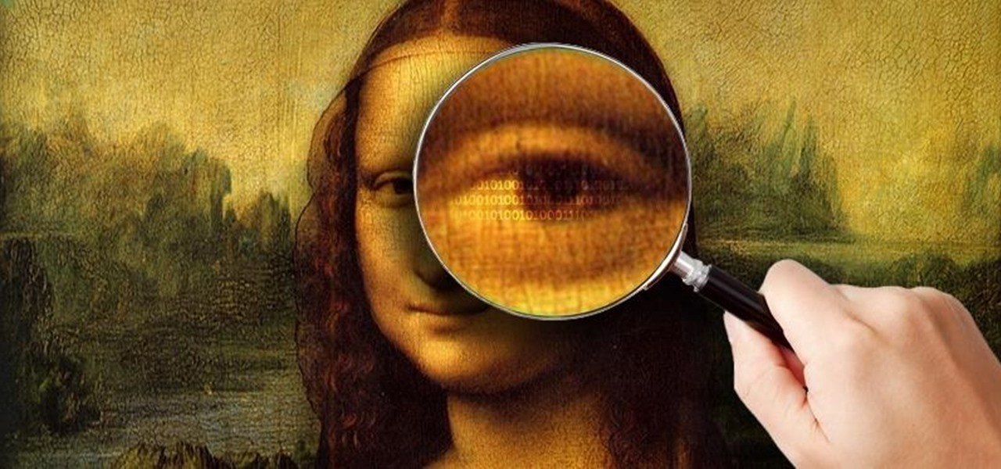
Steganography
Steganography is simply hiding a message inside a file. It is a form of covert communication.
Any environment can be used to hide messages.
Steganography is not an encryption method.
Notes:
It ensures the confidentiality of communication, ensuring that no one, except the sender and the recipient, suspects the existence of a sent message.
Messages are hidden inside other files without changing their structure. there is no difference between the original file and the file with the hidden message in it.

Slide 6
A Brief History of Steganography
Herodotus engraved the rebellion message he would send during the Persian attack on the head of one of his slaves.
Wax tablets were widely used in ancient Greece.
In the war between the French and the Germans, both sides provided messaging with invisible inks.
During the Second World War, the Japanese national agent hid in New York in disguise.
In A Beautiful Mind, it is seen that John Nash, a mathematician, searches for hidden messages in newspapers and magazines.
Notes:
Throughout history, information hiding methods have been used for many purposes. Examples of these are political or diplomatical negotiations, pre-war preparations, wars etc.
The first known uses of steganography date back to ancient times.
When the slave's hair grows, the message was hidden. In this way, he sent the message without attracting attention. When the slave went to the receiver, the receiver asked him to shave his head. So, the message reached its destination.
Messages were written on the wooden part of the wax tablets. These messages were hidden by covering them with wax. These tablets looked like an unused wax tablet at first glance, but when the wax was melted, it was understood that the tablet contained a message. Thus, the secret message could be read.
That's why people were trying to develop new invisible ink formulas to reveal the messages of their enemies.
He was sending the letters disguised as business letters.

Slide 7
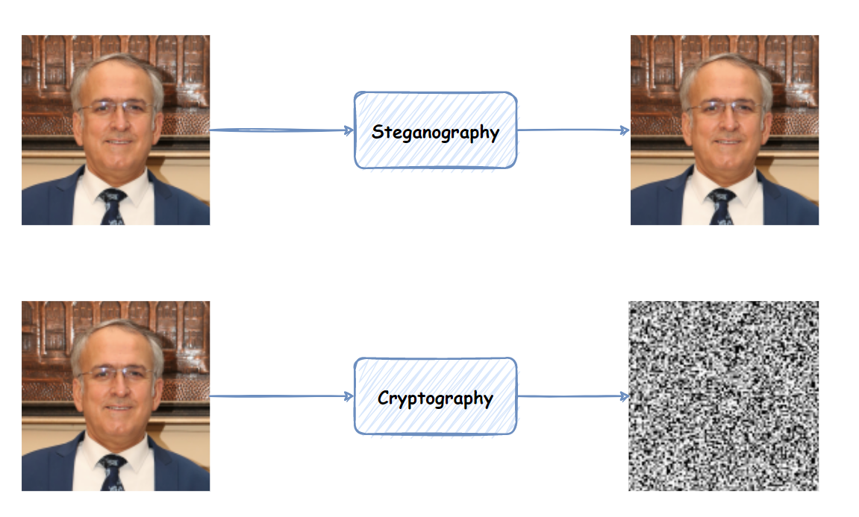
STEGANOGRAPHY VS CRYPTOGRAPHY
Notes:
Cryptography and steganography are very similar. The purpose of both is to protect information, but the methods used are different. In cryptography, the message is hidden by making it incomprehensible, while in steganography the existence of communication is hidden. In cryptography the data is visible but unreadable whereas in steganography the message is not.
In cryptography a key is required to encrypt the message whereas in steganography the key requirement is optional. In cryptography, the decryption key is needed to convert the encrypted message to the original message and thus learn the message. In steganography, once the existence of this message is understood, the data in the secret message becomes available to everyone

Slide 8
TYPES OF STEGANOGRAPHY
Notes:
Secondly, we will talk about the types of steganography.

Slide 9
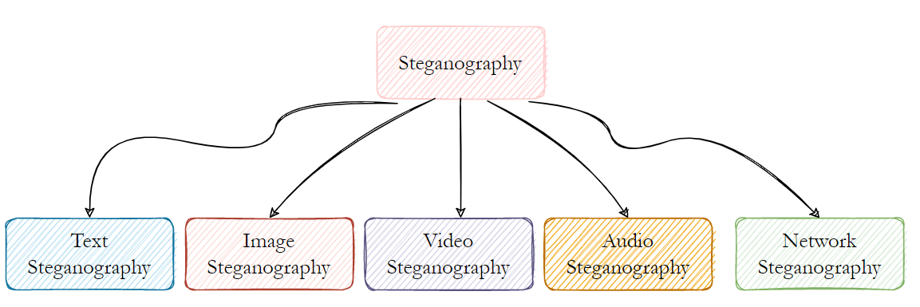
Types of Steganography
Steganography types are divided into five according to the environment in which the messages are hidden: Text Steganography, Image Steganography, Audio Steganography, Video Steganography and Network Steganography.

Slide 10
Text Steganography
Format Based Methods
Text Steganography
Linguistic Steganography
Random and Statistical Generation
The method in which the message is hidden in a text is called text steganography.
Notes:
In format-based methods, it is physically changing the format of the text to hide the massage in the text. When the file with the text hidden inside is opened with a word processor, additional spaces in the text, spelling mistakes, and capitalization changes are seen.
In Random and Statistical Generation, it can be prevented corresponding with a known plaintext, steganographers provide resort to creating their own cover texts. One method is concealing data in random viewing sequence of characters.
In Linguistic Steganography, the mechanism of the language is used to hide the text, taking into account the characteristics and linguistic features of the language.

Slide 11
Image Steganography
Least Significant Bit
Image Steganography
Algorithms and Transformation
Masking and Filtering
Image steganography is the hiding of a message such as text or sound inside the image.
Notes:
One of the most basic methods in the field of steganography is the Least Significant Bit (LSB) algorithm. In this algorithm, the message to be hidden in the image is first made into binary. The binary message is embedded in the least significant bit of the bits in the image. In this algorithm, the bits to hide the message are selected sequentially, not in a different way. In the decryption process, the reverse of the message embedding process is performed. A message is created by combining the values in the least significant bit of each pixel in the image.
In masking and filtering, The message hidden in an image is masked by a faded image. In this way, messages are hidden inside the image so that the human eye cannot see them.
In algorithms and transformation, Different transformation algorithms can be used to embed the message in the image. Frequency transformations such as Discrete Fourier Transform, Discrete Cosine Transform, Discrete Wavelet Transform are examples of these transformation algorithms.

Slide 12
Audio Steganography
Least Significant Bit
Audio Steganography
Spread Spectrum
Echo Data Hiding
Phase Coding
In the audio steganography method, the message is hidden in an audio signal.
Notes:
In LSB, A binary message is replaced with the least significant bits of the audio file. Large amounts of data can be encoded with this method. But LSB is vulnerable to manipulation.
In Phase Coding, The original audio file is split into short segments. DFT (Discrete Fourier Transform) is applied to each segment and then the phase difference is calculated for each. New phase frames are created after calculating the phase difference for all segments. The phase and original magnitude are connected to make a new segment. All segments are interconnected for convenient encrypted output.
Spread Spectrum: the message is embedded in the original audio using the Direct Sequence Spread Spectrum (DSSS) method. In Direct Sequence Spread Spectrum, the signal is multiplied by a pseudo-random sequence of a certain maximum length.
Echo Data Hiding: The data is hidden to the signal with the use of echo. The data is embedded in the audio signal by adding echo to the signal.

Slide 13
Video Steganography
Embed the message in the uncompressed raw video.
Video Steganography
Embed the direct message into the compressed video stream.
In the video steganography method, the message is hidden in the videos.
Notes:
It can be said that the video steganography method is a combination of sound steganography and image steganography methods.
There are two different ways to follow the steganography in the video. The first is to embed the message in the uncompressed raw video and then compress the video. The other is to embed the direct message into the compressed video stream.

Slide 14
Areas
Where Steganography Is Used
Notes:
Another topic is the areas where steganography is used.

Slide 15

Areas Where Steganography Is Used
Steganographic Attacks
Agents
Games
Printers
Notes:
Malicious people use steganography methods when attacking. They normally embed their malware inside seemingly safe files. There are many different ways malicious people can reach their victims. The first of these is digital media files. They can embed malware in a photo on a website or in an email signature. In another method, malicious people imitate a legal website. Any interaction with this website results in the downloading of malicious software.
Steganography has historically been popular with agents. During the spying, they communicated by hiding secret messages with steganographic methods. Hidden messages are embedded in files such as images, sounds or video.
Steganography can also be used in games. Steganography and cryptography are used together in the puzzles offered by Cicada 3301.
Some printers use steganography. Printers have been known to add hard-to-see little yellow dots to every page. Dots represent printer serial numbers, date and time.

Slide 16
STEGANALYSIS
Notes:
The next topic we will talk about is steganalysis

Slide 17
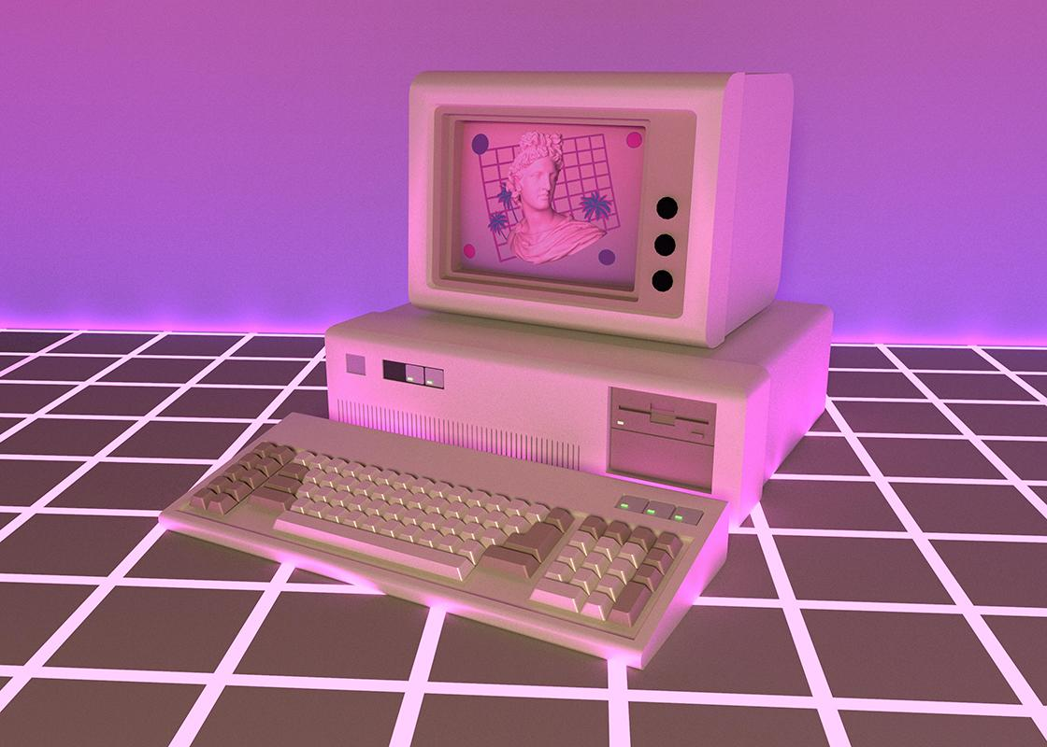
Steganalysis
Steganalysis is used to detect the presence of a hidden message in a file.

Slide 18
Steganalysis
Visual Detection
Histogram Analysis
High-Order Statistical Analysis
It is called visual detection of some anomalies that occur as a result of data embedding in images.
This method is based on the statistical analysis of the changing pixel value pairs as a result of data embedding in the image.
In this method, in addition to the histogram analysis, statistical analysis of the positions of the pixels where the change takes place is also performed.

Slide 19
Steganalysis
Algorithm or Type-Specific Detections
Universal Detection Systems
It includes steganalysis methods developed specifically for image types with extensions such as JPEG.
The features of the image are extracted and compared with the original image.

Slide 20
Methods Used In the Project
PROJECT
Notes:
Now we will talk about the methods we use in the project.

Slide 21
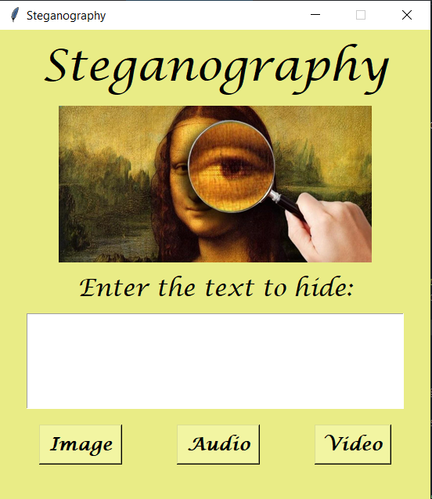
Project
Methods
For STEGANOGRAPHY:
Least Significant Bit
For CRYPTOGRAPHY:
RSA
Notes:
In this project, we develop a Steganography tool including Image, Audio and Video Steganography has been developed. In this tool, a message can be hidden in image, audio and video.
The main purpose of this developed project is to establish a connection and ensure that the message reaches the target correctly, without the presence of the message being perceived by people other than the parties to communicate.

Slide 22
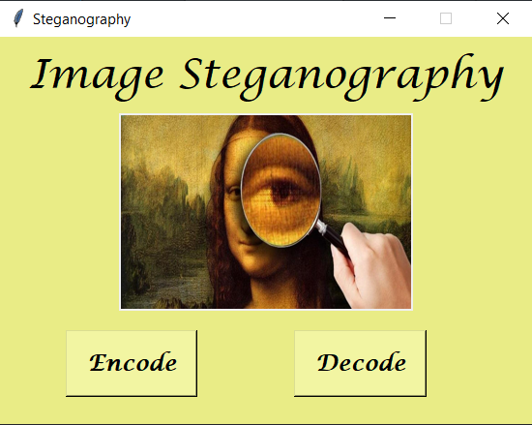
Project: Image Steganography
In the scope of Image Steganography, all images are converted to RGB.
The message to be hidden is encrypted with the RSA algorithm.
The message is then sequentially embedded in the least significant bit within the three channels.
In the decode operation, the reverse of the encode operation is applied.
Letters are created by combining the values in the least significant bit by going to the 3 channels in the image sequentially.
The generated letters are decrypted with the RSA algorithm and the message is revealed

Slide 23
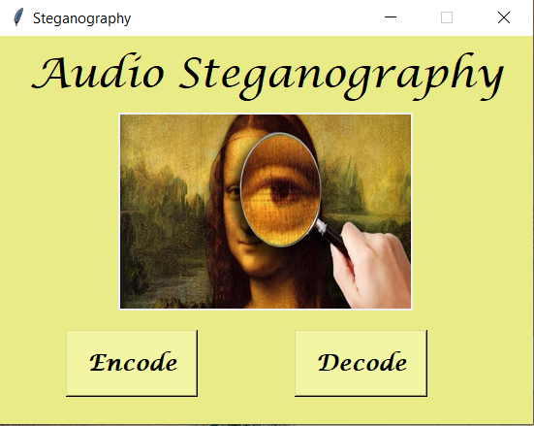
Project: Audio Steganography
The message to be hidden is encrypted with the RSA algorithm.
The audio file is converted into frames. The frames in the audio file are converted to binary.
Then, by applying the LSB technique to these binary values, the message is embedded by changing the least significant bit.
For decoding process, the reverse of the encoding process is applied.
Only .wav files are supported under Audio Steganography.

Slide 24

Project: Video Steganography
Within the scope of Video Steganography, the audio is separated from the video and the video is divided into frames. Thus, since there are two different file types as sound and image, steganography techniques of these file types can be used.
While video steganography is being performed, the message can be embedded in images if desired. Image steganography techniques are used to embed the message in images. Audio steganography techniques can also be used to embed the message in audio files.

Slide 25
DEMO

Slide 26
THANKS!

